Slide 1
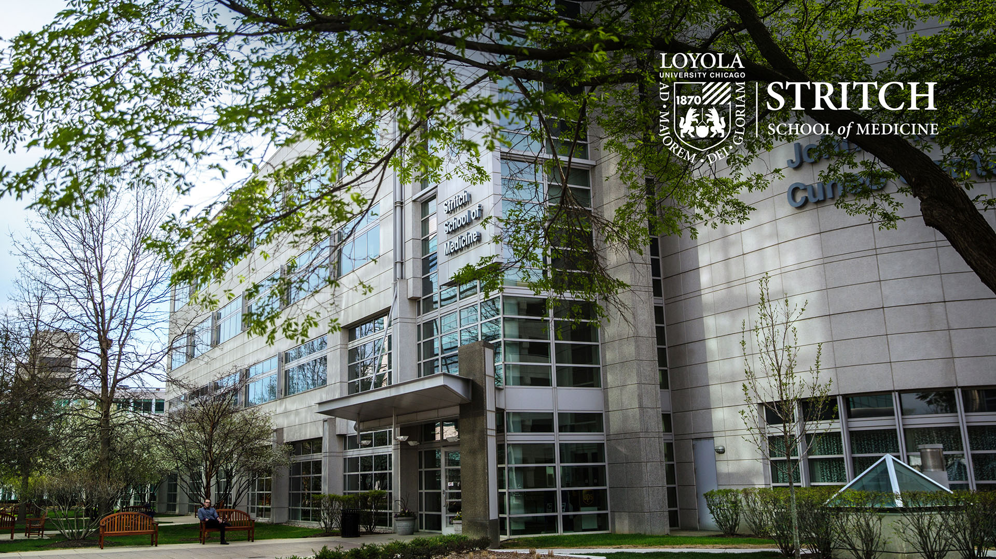
Welcome to LUC Stritch School of Medicine
Sam J. Marzo, MD
Dean SSOM

Slide 2
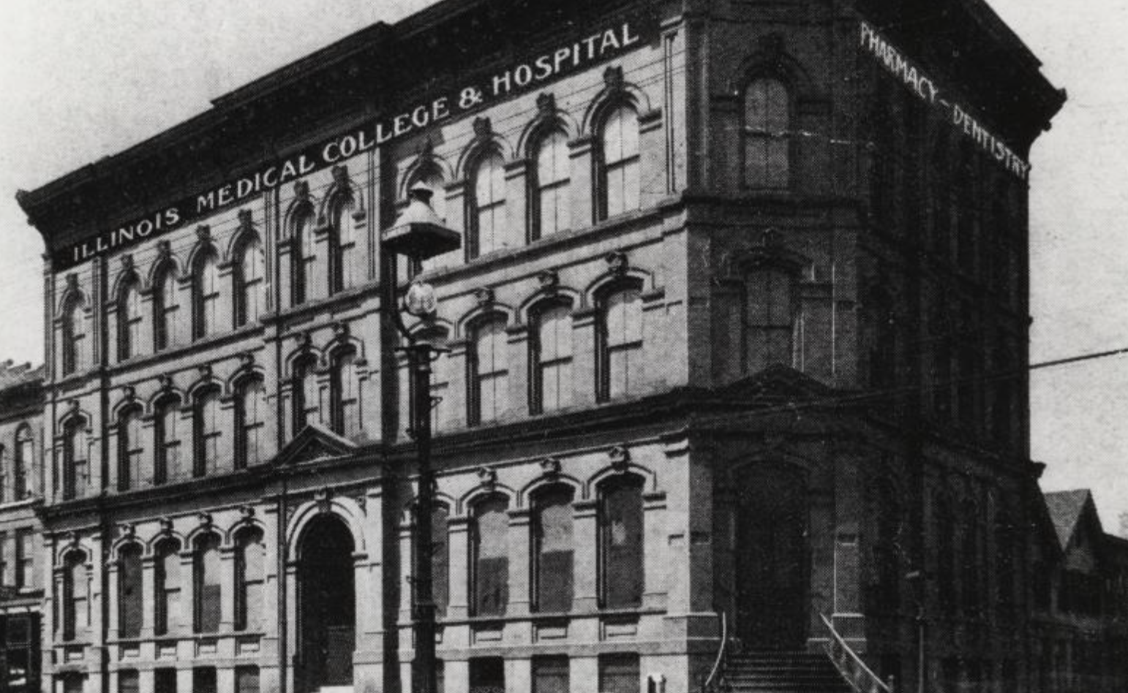
Loyola History
LUC established 1870
Medical Department of Loyola University established September 1909 with an affiliation with the Illinois Medical College
Named Stritch School of Medicine (SSOM) in 1948, in honor of Samuel Cardinal Stritch, Archbishop of Chicago.
US Gov deeded 62 acres of land adjacent to HVAH in 1962 to establish LUMC Moved 1968.
In 1997, SSOM moved into new Medical Ed building in 2001.
LUMC sold to Trinity Health 7/1/2011
Significant financial support from LUHS ($30 million/yr)

Slide 3
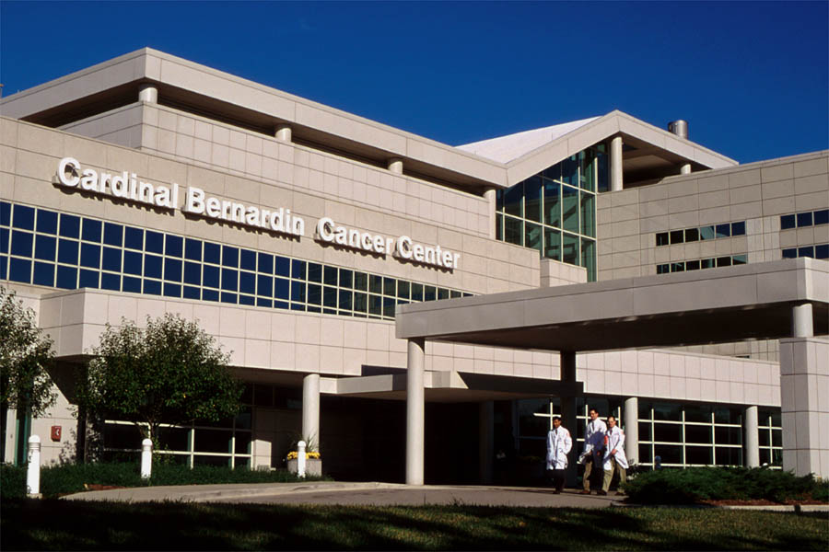
Cardinal Bernardin Cancer Center (CBCC)
Built in 1994 and subsequently named in honor of the late Archbishop of Chicago Joseph Cardinal Bernardin
Brings together all aspects of cancer care at one site with multidisciplinary clinics
Clinical and Research Spaces
Cancer Biology Basic Science Department
Cellular Therapy Center

Slide 4
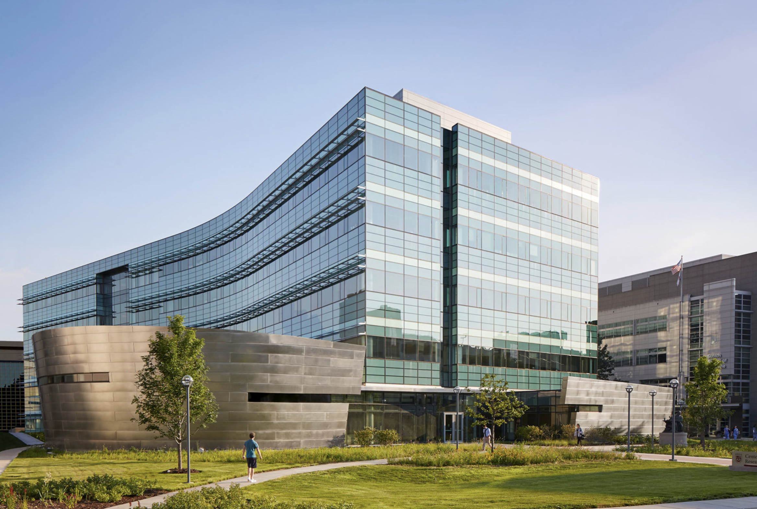
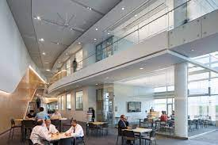
Center for Translational Research & Education (CTRE)
$137 million LUC/LUHS joint venture.
5 story, 250,000 square feet.
Opened in April 2016.
500 research investigators, trainees, staff.
Houses 3/4 Basic Science Departments:
  Cellular and Molecular Physiology.
  Microbiology & Immunology.
  Molecular Pharm & Neurosciences.
Research Institutes:
  Burn & Shock Trauma.
  Cardiovascular.
  Infectious Disease.
  Neuroscience.

Slide 5
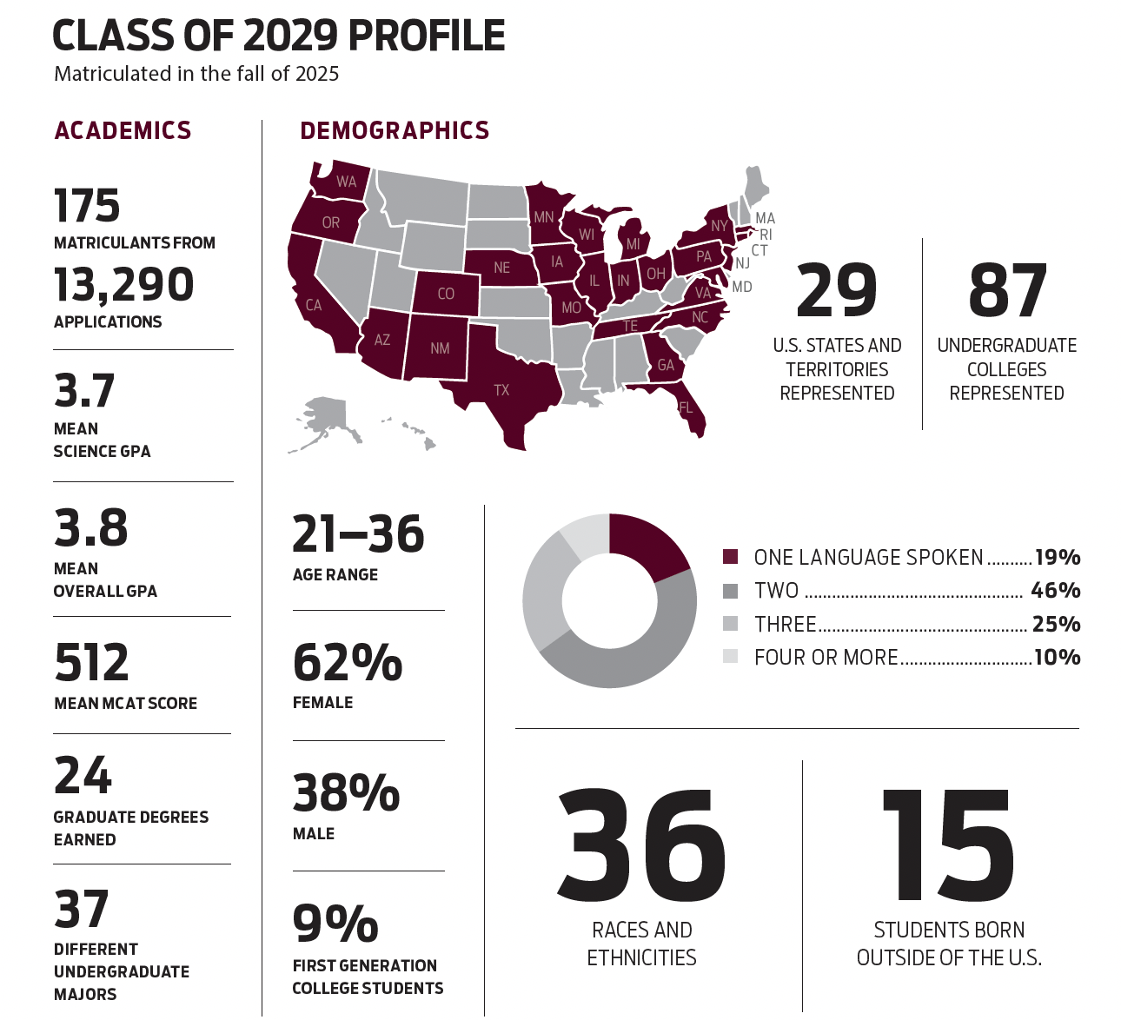
SSOM ADMISSIONS

Slide 6
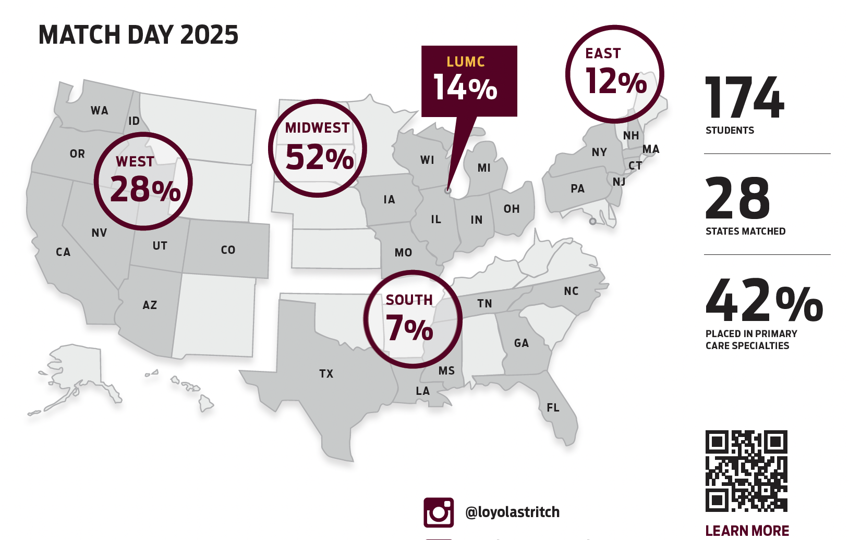
SSOM ADMISSIONS
*Approx 38% of residents stay at their Training Program

Slide 7
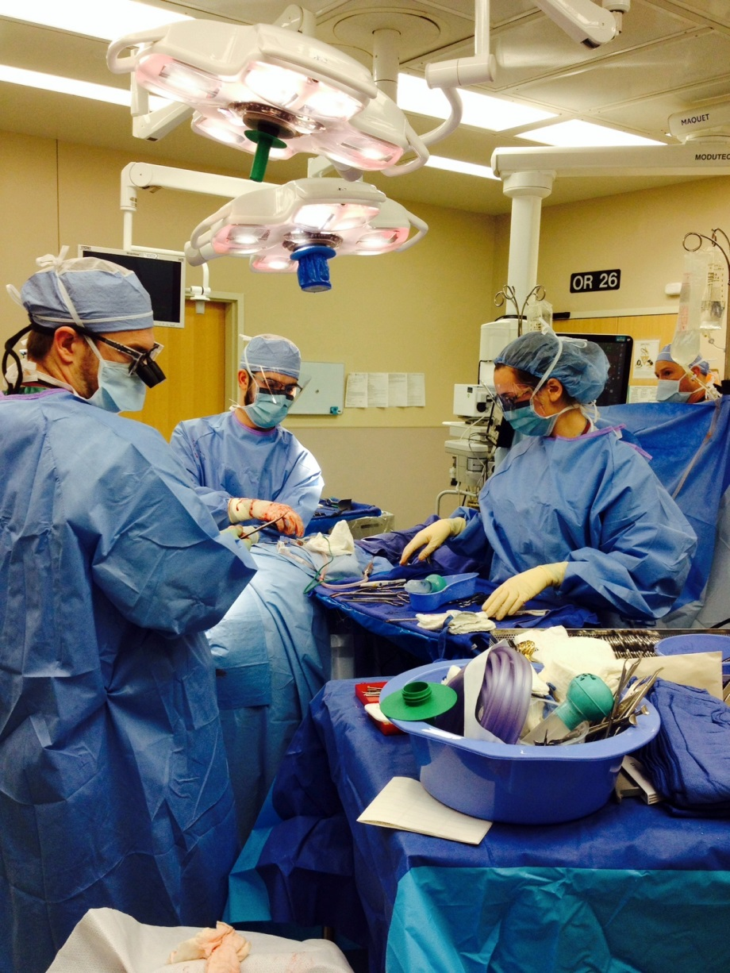
LUHS 18 Clinical Departments Provide Outstanding Clinical Care, Educational Training, and Research
Anesthesia
CV/CT Surgery
Emergency Medicine
Family Medicine
General Surgery
Medicine
Neurology
Neurosurgery
OBGYN
Otolaryngology HNS
Ophthalmology
Orthopedics
Pathology
Pediatrics
Psychiatry
Radiology
Radiation Oncology
Urology

Slide 8
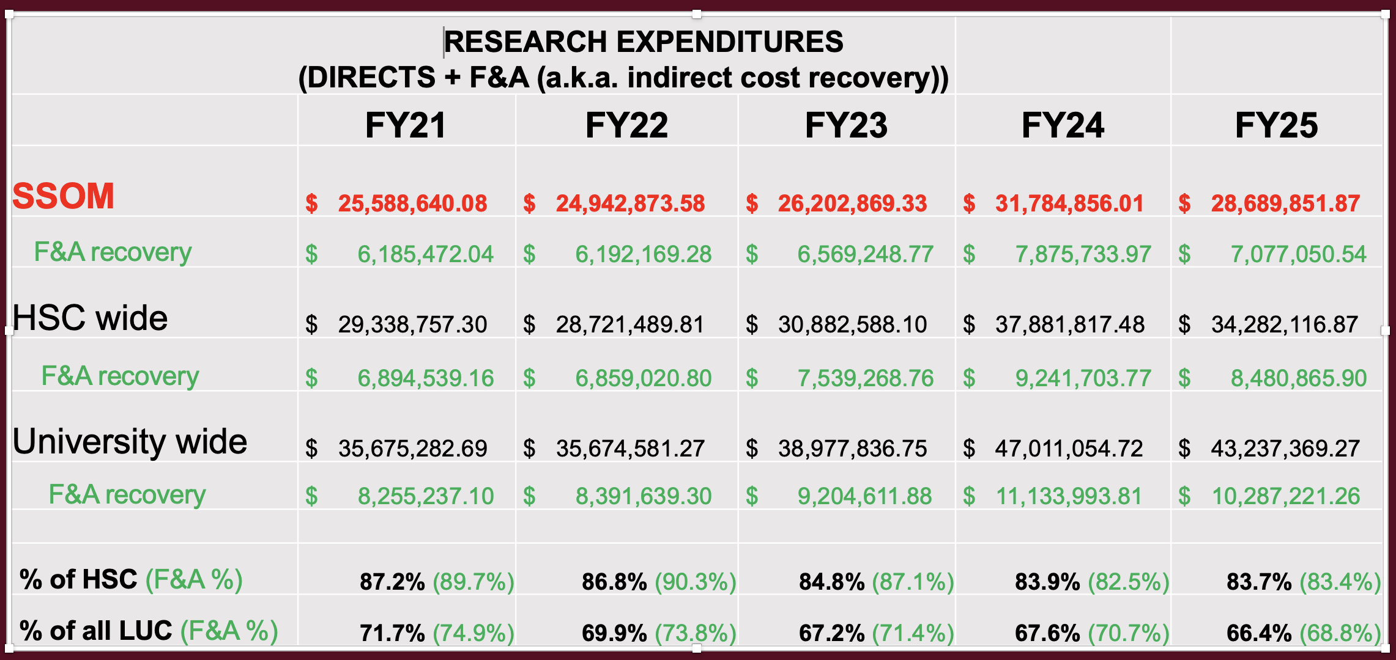
SSOM/LUC Research Expenditures

Slide 9
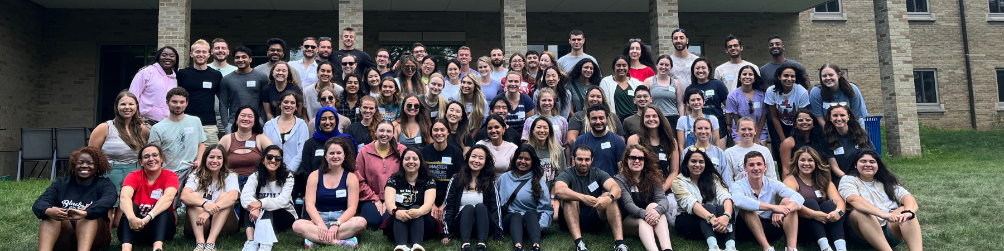
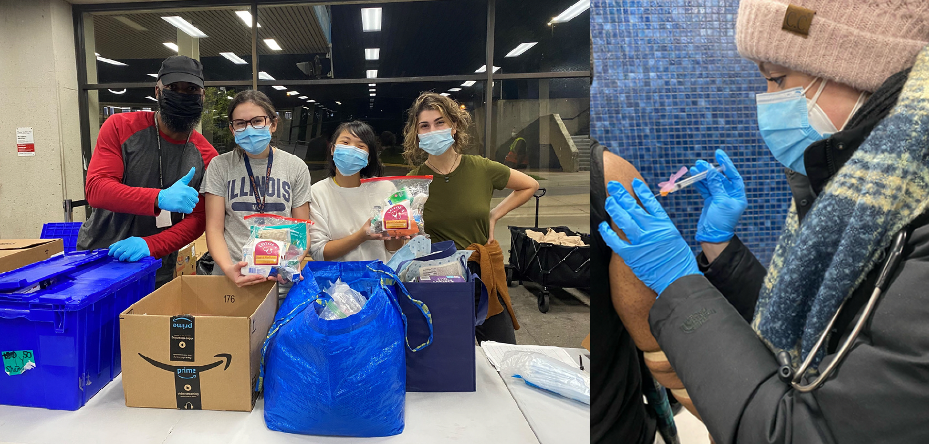
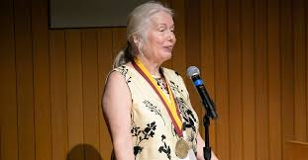
Catholic Jesuit Identity
Health Sciences Campus Ministry
JUMP (Jesuit U Ministry Preview) Retreat
Day of Community & Service
Chaplain Mentor Program
Anatomical Donor Service of Gratitude
Ignatian Service Immersion
Physician Vocation Program
Patient Centered Medicine/Cura Personalis
Medical Spanish & Polish Programs
Center for Community & Global Health (CCGH)
Annual Stritch Medal and Alumni Award Ceremony

Slide 10
Thank you

